Slide 1
Secure data hiding in image using steganography
CAPSTONE PROJECT
Presented By:
Student Name : Viswanathan S
College Name & Department : Valluvar college of science and management , Karur & B.Sc(Computer Science)

Slide 2
OUTLINE
Problem Statement
Technology used
Wow factor
End users
Result
Conclusion
Git-hub Link
Future scope

Slide 3
Problem Statement
Create a GUI-based Python application to hide and retrieve secret messages in images using Tkinter.
Allow users to select an image, enter a message, and set a password for encryption.
Modify pixel values to encode the message and save the encrypted image along with the password.
Implement password-protected decryption to extract and display the hidden message.
Provide user feedback through message boxes and open the encrypted image for viewing.

Slide 4
Technology used
The technologies used in the project include:
Python – Core programming language for the application.
Tkinter – GUI library for creating the user interface.
OpenCV (cv2) – Image processing library for reading and modifying images.
PIL (Pillow) – Used for handling and displaying images in the GUI.
OS Module – For handling file operations like opening images and saving passwords.

Slide 5
Wow factors
The "Wow Factor" of this project includes:
Steganography-Based Encryption – Hides secret messages within images using pixel manipulation, making it discreet and secure.
Password Protection – Ensures only authorized users can decrypt the message, adding an extra layer of security.
User-Friendly GUI – Provides an intuitive interface for easy encryption and decryption without technical expertise.
Real-Time Image Preview – Displays a thumbnail of the selected image, enhancing user interaction.
Automated Image Opening – Opens the encrypted image instantly after processing, offering a seamless experience.
This project is a simple yet powerful way to send hidden messages without raising suspicion!

Slide 6
End users
Privacy Enthusiasts – Individuals who want to send hidden messages securely.
Cybersecurity Professionals – For testing and learning steganography techniques.
Journalists & Activists – To protect sensitive information from surveillance.
Students & Researchers – For academic projects and cryptography studies.
General Users – Anyone interested in a fun and secure way to hide messages in images.

Slide 7
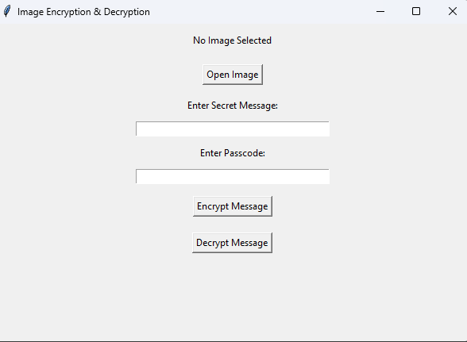
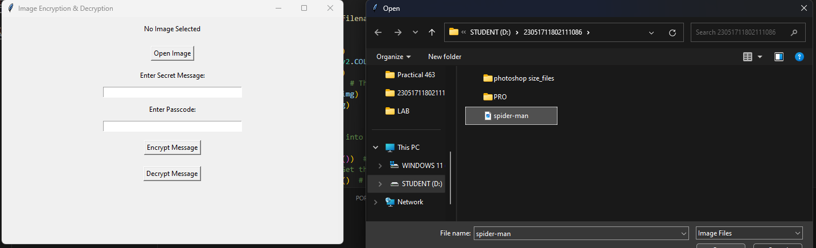
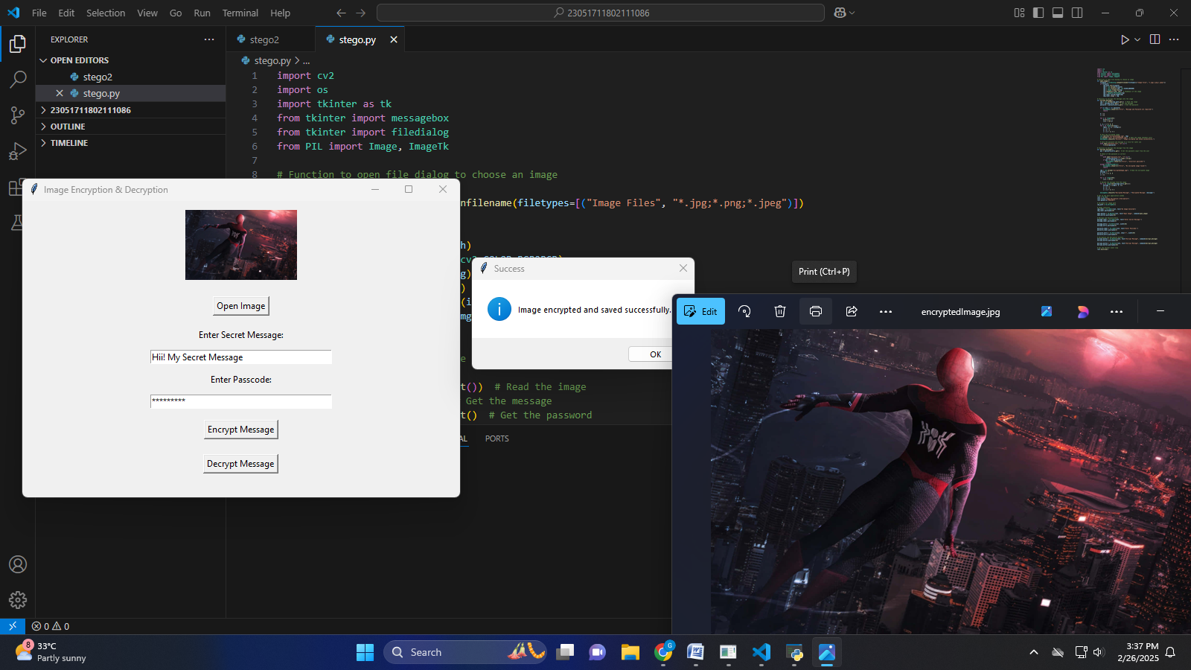
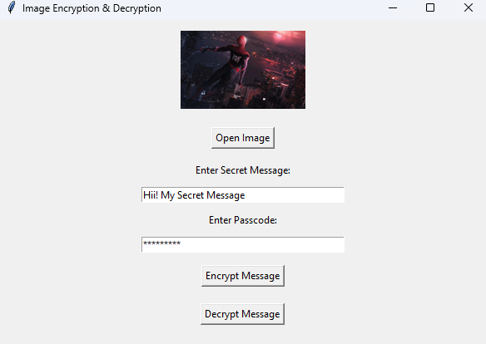
Results

Slide 8
Conclusion
This project demonstrates a simple yet effective way to hide and retrieve secret messages using image steganography. By integrating Tkinter for GUI,OpenCV for image processing, and password protection, it ensures both usability and security. The tool is useful for privacy-conscious users, cybersecurity enthusiasts, and researchers. With its intuitive interface and real-time image preview, it provides a seamless experience. Overall, this project is a fun and practical approach to secure communication.

Slide 9
GitHub Link
https://github.com/SK-Viswa-086/Internship-Report.git

Slide 10
Future scope
Enhanced Security – Implement stronger encryption algorithms for better protection.
Support for Multiple File Formats – Extend compatibility beyond images (e.g., videos, audio).
Improved Steganography Techniques – Use advanced LSB (Least Significant Bit) or AI-based methods.
Cross-Platform Support – Develop a web or mobile version for wider accessibility.
Cloud Storage Integration – Allow encrypted images to be stored and shared securely online.

Slide 11
THANK YOU

